Slide 1


L4: Device & Block Layers
Chun-Feng Wu (吳俊峯)
Assistant Professor, National Yang Ming Chiao Tung University
cfwu417@cs.nycu.edu.tw
https://cfwu417.github.io

Slide 2
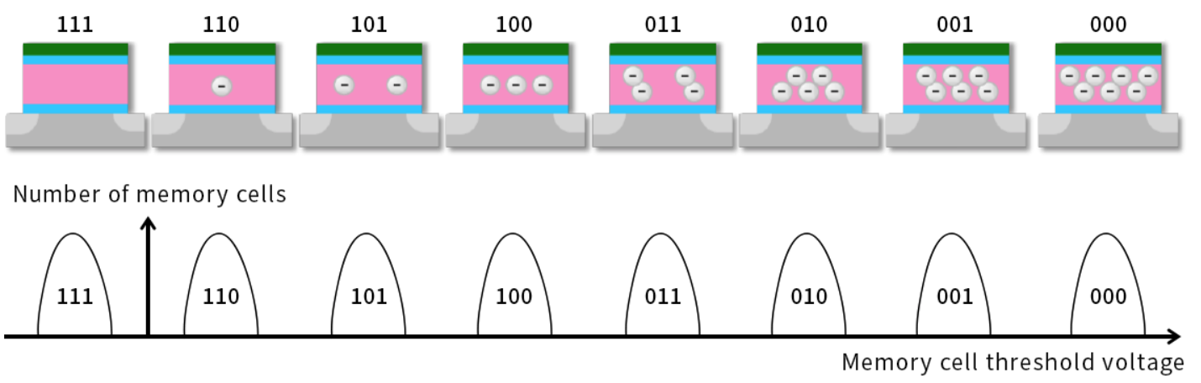
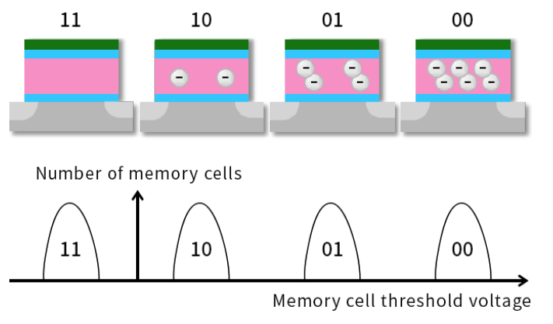
Recall: Multi-Level Cells
Is it possible to let a cell represent more than one bit?
Ans: A cell can represent two bits, if there are 4 verifiable voltage states in the cell
Single-Level Cell (SLC): One-bit per cell
Multi-Level Cell (MLC): Multiple-bits per cell, 2^{#bits} voltage levels
11 → No Electron
10 → 1/3 Electrons
Control gate
Dielectric
01 → 2/3 Electrons
00 → Full Electrons
Why distributions?
P-substrate
n-source
n-drain
2-bits MLC
Illustration of 2-bits MLC
Illustration of 3-bits MLC (or TLC)
Ref: https://www.kioxia.com/en-jp/rd/technology/multi-level-cell.html

Slide 3
Recall: SSD’s Architecture
Flash Translation Layer:
Sequential Write Constraint → Sol: Address Remapping (Logical Block Address to Physical Block Address) + Garbage Collection
Limited Lifetime → Sol: Wear Leveling
Memory Technology Device (MTD): Interact (read/program) with NAND Flash chips.
Device Driver
SSD
Controller
Flash Translation Layer (FTL)
Address Translator
Garbage Collector
Wear Leveler
Memory Technology Device (MTD)
NAND Flash Block 1
NAND Flash Block 2
NAND Flash Page
NAND Flash Page (Latest)
DRAM
Translation Table
Data Buffer
LBA 500
……
1110011000110110110101001
PBA 800
1010111100111110000101010
NAND Flash Chips
NAND Flash Chips
Read Modify
Write
LBA 500 → PBA 1201
NAND Flash Chips
NAND Flash Chips
Mark as invalid
Update the Mapping
NAND Flash Chips
NAND Flash Chips
…

Slide 4
Recall: Interaction with the Peripherals
How CPU accesses peripherals
Port-Mapped I/O (Isolated I/O): CPU accesses peripherals by IN/OUT instructions where the I/O address space is separated from the memory address space.
Memory Mapped I/O: CPU accesses peripherals by load/store instructions where the I/O address space is shared with the memory address space.
Direct Memory Access (DMA): Transfer data directly between memory and I/O devices without CPU’s interventions.
CPU
CPU
CPU
Memory
in/out
load/store
I/O Ports
Memory Address
load/store
load/store
0x0000
0xFFFF
0x0000
0xFFFF
DMA Controller
I/O Addr.
Memory Addr.
I/O Addr.
Memory Addr.
I/O Device
I/O Device
I/O Device
Port-Mapped I/O
Memory-Mapped I/O
DMA

Slide 5
Process
sys_read()
sys_write()
User
Kernel
Virtual File System
Device Driver
Page Cache
Mapping Layer (FS Specific)
Block I/O Layer
Block Device Driver
Devices
(e.g., HDD, SSD)

Slide 6
A Split View of the Kernel I/O Stacks
Block Devices: Addressable in device-specified chunks called blocks and generally support seeking, the random access of data.
Mounted as a file system
Suited for handling data blocks with a fixed number of bytes.
Character Device: Providing access to data only as a stream, generally of characters (bytes)
Suited when the volumes of data transferred are low.
Applications
Kernel
Kernel I/O Subsystem
Keyboard Device Driver
Mouse Device Driver
SAS Device Driver
USB Device Driver
PCIe Bus Device Driver
Keyboard Device Controller
Mouse
Device Controller
SAS
Device Controller
USB
Device Controller
PCIe Bus
Device Controller
Keyboard
Mouse
SAS Devices
USB Devices
PCIe Bus
(Character)
(Character)
(Block)
(Block)
(Character)
Hardware

Slide 7
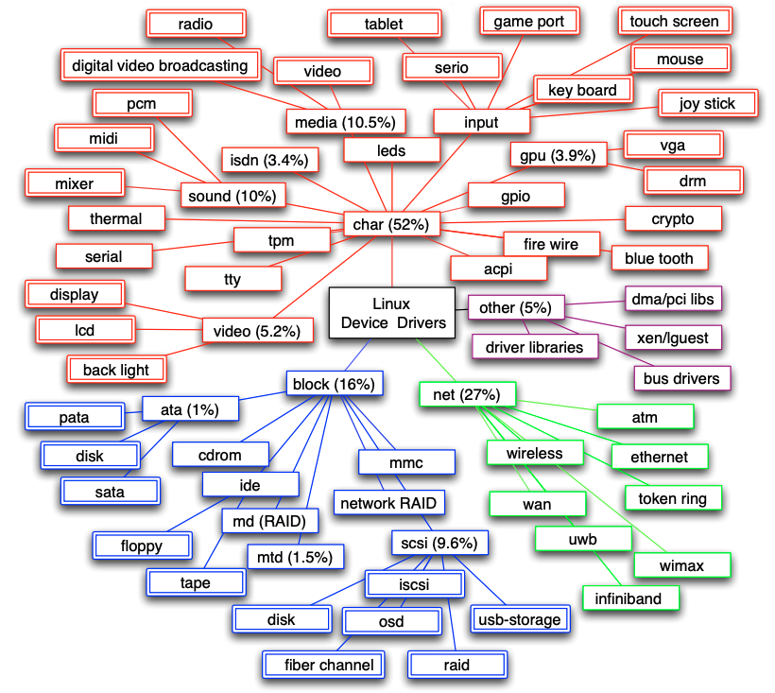
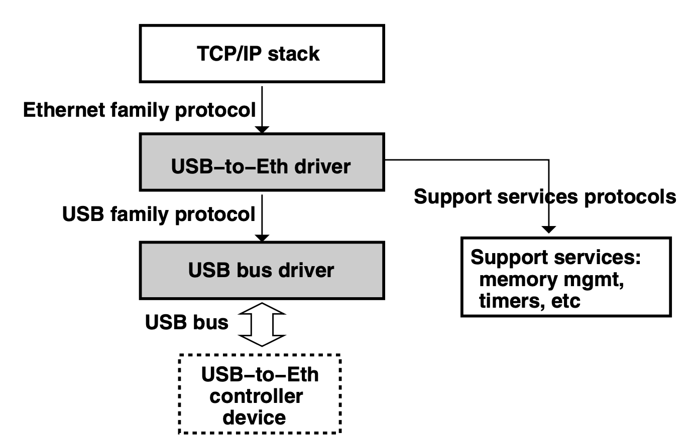
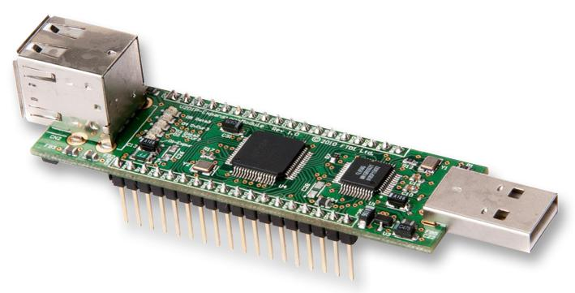
More About Device Driver
70% of Linux kernel code is device driver
Compositions of device driver (Linux 2.6):
52% Char device drivers
16% Block device drivers
27% Network device drivers
An example of network device driver
Linux Network Stack
Export network interface
Pack/Unpack USB packets
[1] L. Ryzhyk, P. Chubb, I. Kuz, and G. Heiser. Dingo: Taming device drivers. In Eurosys, 2009.
Notes:
The driver implements the Ethernet family protocol that exports the network interface functionality to the OS network stack.
Since the device in question is connected to the USB bus, it cannot be accessed by the driver directly. Instead, device protocol messages must be encapsulated in- side USB data packets submitted to the USB bus driver via the USB family protocol. Such driver stacking is common in operating system I/O frameworks and reflects the structure of the underlying I/O bus hierarchy.

Slide 8
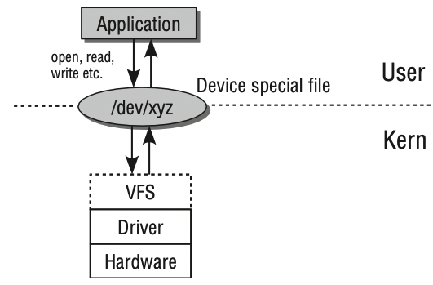
The Role of the Device Driver
Device Driver: A computer program that operates or controls a particular type of device that is attached to a computer. (Hide the details of how device works)
Device (Special) File: Used to interact with drivers for accessing expansion devices. Easier for users to identify corresponding devices.
Kernel modules (e.g., device drivers) are a piece of code, that can be loaded and unloaded from kernel on demand.
Ref: Mauerer, Wolfgang. Professional Linux kernel architecture. John Wiley & Sons, 2010

Slide 9
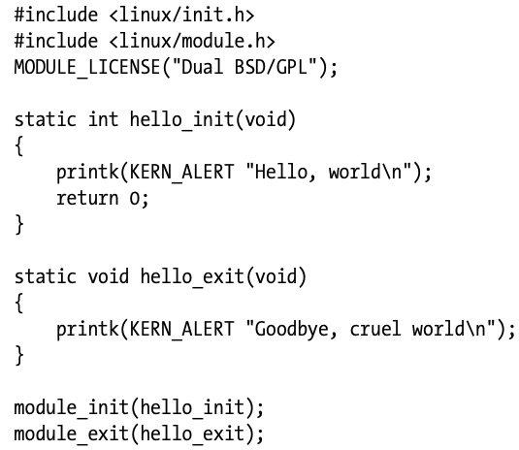
How to Build a Device Driver
Module_init: Kernel runs a function when the module is loaded.
Format: int my_init(void);
Output: Return 0 if it is successful
Purposes: Initialize hardware, allocate data structures.
Module_exit: Kernel runs a function when the module is removed.
Purposes: Free resources, shutdown and reset hardware.
MODULE_LICENSE: Specifies the copyright license for this file.
Linux Kernel Development, 3rd Edition

Slide 10
How to Build a Device Driver (Count.)
Source Tree: (1) Store driver code (e.g., c files) in the correlated directory (e.g., drivers/block or drivers/char). (2) Modify the Makefile in the directory (Please refer to P.341 in the textbook, Linux Kernel Development.
Build Externally: Maintain and build our module outside the kernel source tree. Create a Makefile by adding two commands
obj-m := hello_world.o
make –C /lib/modules/$(shell uname –r)/build M=$(PWD) modules
Compiles hello_world.c into hello_world.ko
Go to the directory and read the Makefile
Go back to the prior directory and read the Makefile

Slide 11

Kernel Programming
How to access the ``current’’ process: Kernel code can access the global item current, which has a pointer points to struct task_struct.
Why it works: most actions run by the kernel are done on behalf of a specific process.
Ex: printk(KERN_INFO "The process is \"%s\" (pid %i)\n",current->comm, current->pid);
Kernel Address Space (Virtual)
Kernel Module
CPU
System Call!!
Process A
User Mode
User Mode
Kernel Mode
Kernel Mode
User Program
User Address Space (Virtual)
Process A
Process Data
Main Memory

Slide 12
Kernel Programming (Count.)
How to access the current process: Kernel code can access the global item current, which has a pointer points to struct task_struct.
Why it works: most actions run by the kernel are done on behalf of a specific process.
Ex: printk(KERN_INFO "The process is \"%s\" (pid %i)\n",current->comm, current->pid);
Cautions for kernel programming:
Super small stack: With using virtual memory, applications have large stack area virtual memory, the kernel instead has a very small stack (Only 1~2 pages).
Kernel function with _ _: Usually low-level components. Should be used with caution.
Do not use floating points: Floating point support is very expensive in the kernel and should be avoided.
Why expensive: Shall save floating-point registers while switching from user to kernel mode (hundred of cycles)
Notes:
https://stackoverflow.com/questions/13886338/use-of-floating-point-in-the-linux-kernel

Slide 13
Process
sys_read()
sys_write()
User
Kernel
Virtual File System
Block I/O Layer
Page Cache
Mapping Layer (FS Specific)
Block I/O Layer
Block Device Driver
Devices
(e.g., HDD, SSD)

Slide 14
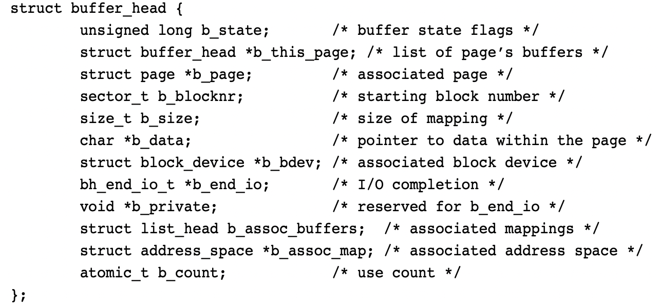
Buffers and Buffer Heads
Sector: The smallest addressable unit of the storage device. (e.g., 512 B)
Block: The smallest addressable unit of the file system. (e.g., 512 B)
Size(Page)>=Size(Block) >= Size(Sector)
Buffer: The object which represents a block in memory.
Buffer Head: A descriptor (i.e., struct buffer_head) for each buffer. (e.g., the buffer is from which block device and from which specific block)
b_state specifies the state of the buffer. (e.g., dirty, lock)
Memory Page (4KB)
Buffer
b_page points to the corresponding page for storing the block.
b_size indicates the size of the block
b_data points to the starting point of the block
b_bdev points to the corresponding block device
Sector
Sector
Block
Block
Storage Device

Slide 15
Challenges of Buffer Heads
Buffer heads play the role of buffer-to-block mapping.
Challenge 1: A large and bulky data structure. A block is smaller than a page, and each buffer is described by a bulky buffer head, thus inefficient.
Sol (2.6 kernel): kernel works directly with pages and address spaces instead of blocks.
Challenge 2: kernel shall break up large block I/O operations into multiple needless buffer_head structures (e.g., each buffer_head represent 512 B).
Sol (2.5 kernel): A new, flexible, and lightweight container for block I/O operations. (bio)

Slide 16
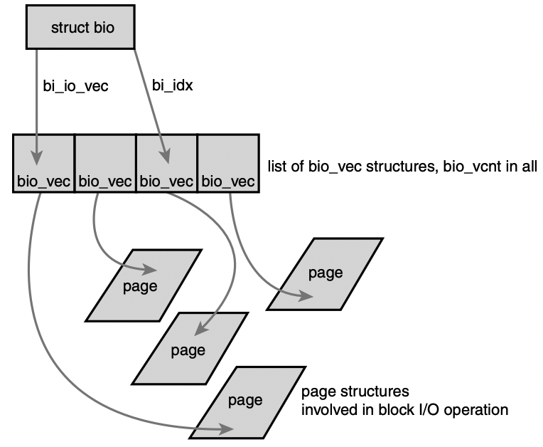
BIO Structure
Bio: A block I/O operation. It can handle a list of non-contiguous segments. (Blocks belonging to an operation need not be contiguous)
Segment: A chunk of a buffer that is contiguous in memory.
One block I/O operation (*bi_next can point to next operation)
Current processing segment (Help to keep track of current progress)
Start of the vec_list belonging to the I/O operation
Segment
<page, offset, len>
Segment
Page Frame
Ref: https://www.byteisland.com/linux-%E9%80%9A%E7%94%A8%E5%9D%97%E5%B1%82-bio-%E8%AF%A6%E8%A7%A3/
Notes:
Even though bio has replaced buffer_head for most file data I/O, buffer_head is still used in many filesystems (like ext4) to read and write metadata (e.g., superblocks, group descriptors, bitmaps, inodes).

